Slide 1
Java Banking Project
By
Vedika.R

Slide 2
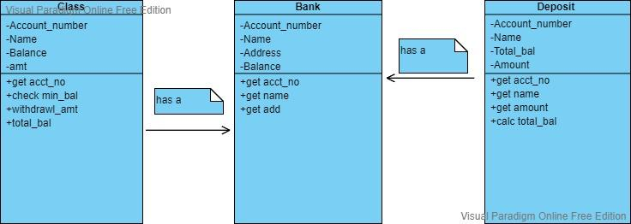
Class diagram

Slide 3
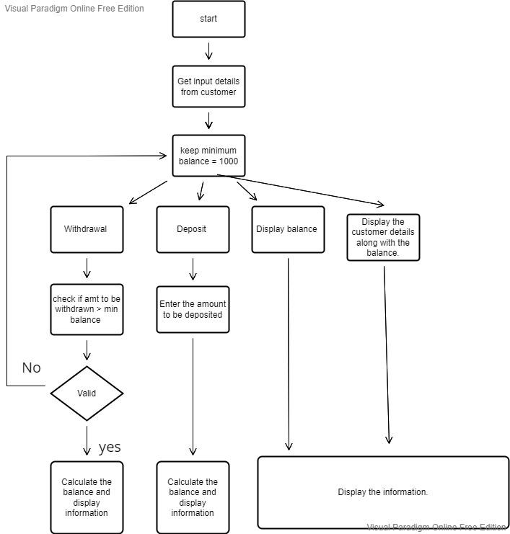
Flow chart diagram

Slide 4
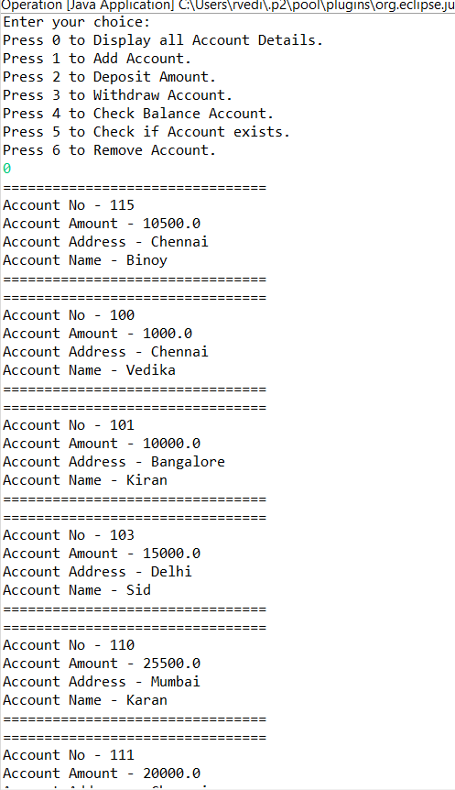
Code output Screenshots

Slide 5
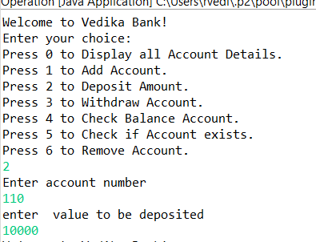
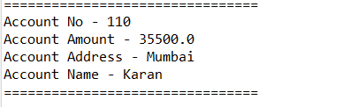
Code output Screenshots
This is an example for depositing the amount in the account

Slide 6
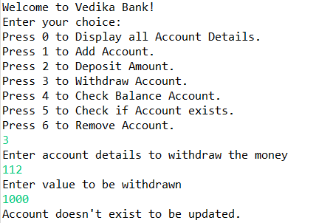
Code output Screenshots
It checks for the account number for each case and looks if it exists or not.

Slide 7
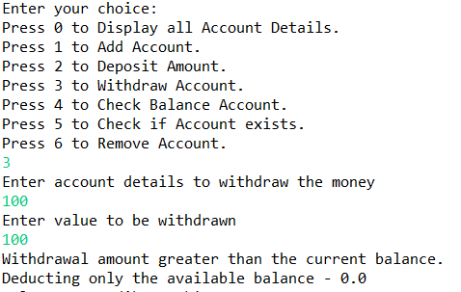
Code output Screenshots
When the withdrawing amount is more than the current balance in the account

Slide 8
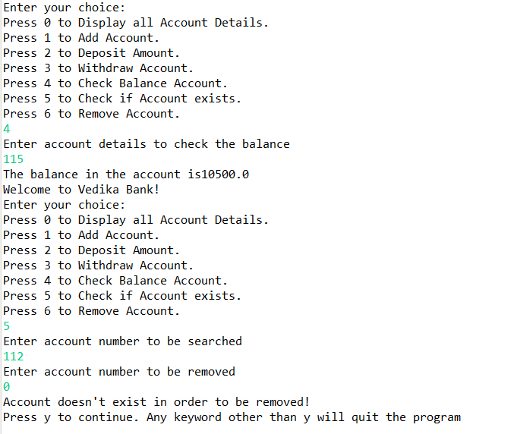
Code output Screenshots
This shows the balance in the account and if the account exists or not . It asks if we want to continue further…

